Slide 1
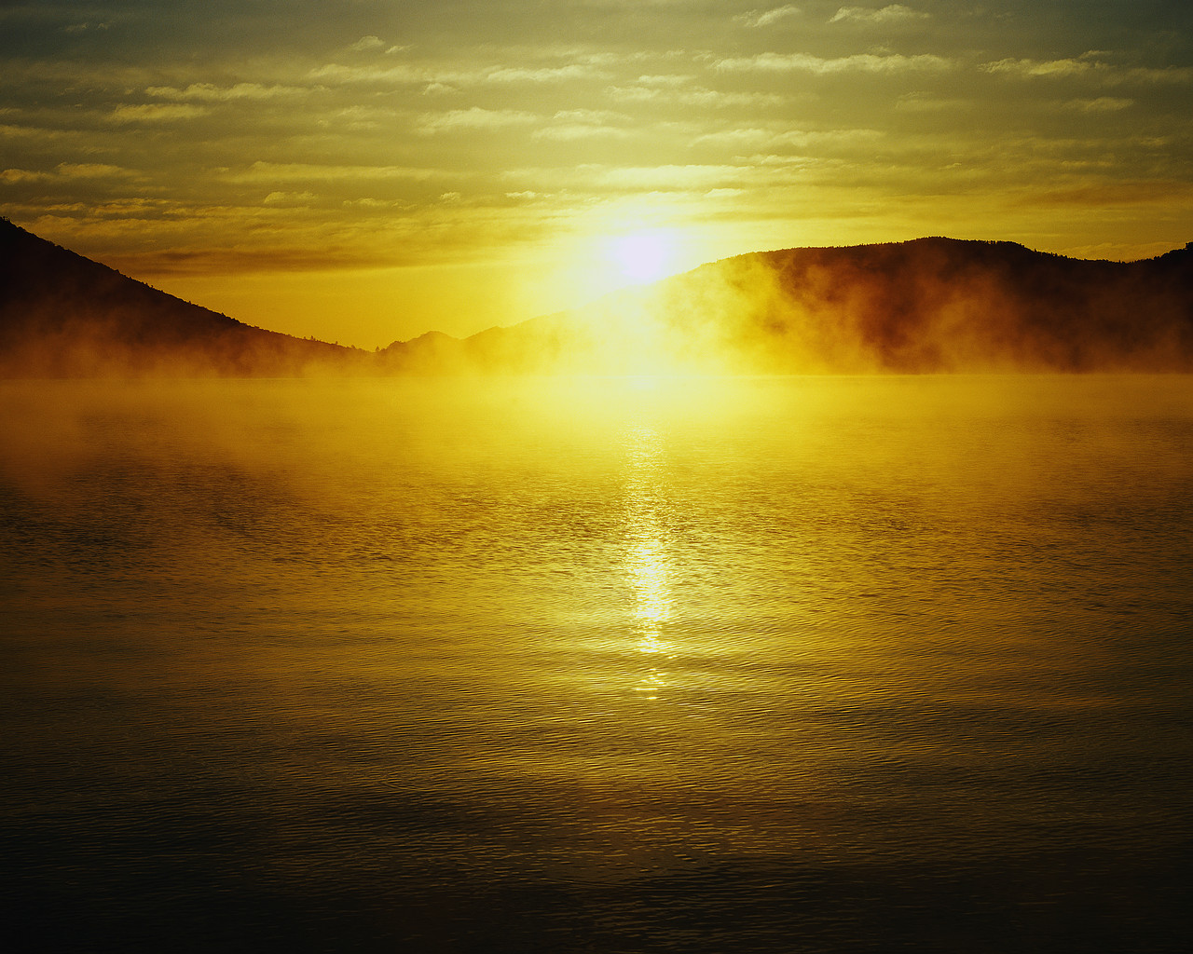

Why You May Know The Bible
Reasons
is the WORD of GOD
(part 3a)
2 Peter 1:19-21

Slide 2
Previously:
Unity of writers
Scientific Accuracy
  Microbiology
  Space Science
  Earth Science
TODAY: THE HISTORICAL ACCURACY OF THE BIBLE AS SEEN IN THE FLOOD

Slide 3
3. Historical Accuracy Of The Bible
Universal Flood (Gen. 6-8)
  Wickedness of man great in the earth
    global wickedness (6:5, 11, 12)
  Regret for the creation of man (6:6)
  Global judgment

Slide 4
Reason For A GLOBAL Judgment
Destroy from the face of the earth (6:7; 7:4)
Destroy them with the earth (6:13)
Everything that is on earth shall die (6:17; 7:21)
Two of every kind will come to you to keep them alive (6:19, 20)
All high hills and mountains covered (7:17-20)
Higher mountains after the flood
(Ps. 104:6-9)

Slide 5
3. Historical Accuracy Of The Bible
Universal Flood (Gen. 6-8)
  Global-flood accounts exist from all around the world
  The biblical account towers above the other accounts as:
    original
    reasonable (the dimensions of ark)
    added moral dimension (Gen. 6:11-13)

Slide 6
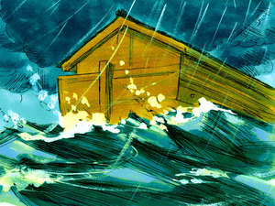
A Universal Flood
Pawnee Indians, Nebraska
“The first people on the earth were giants, very big and strong. They did not believe in the creator Ti-ra-wa. They thought nothing could overcome them. They grew increasingly worse. At last Ti-ra-wa grew angry and raised the water to the level of the land so that the ground became soft…”

Slide 7
A Universal Flood
Pawnee Indians, Nebraska
“…The giants sank into the mud and drowned. Their bones can still be found today. Ti-ra-wa then created a man and woman, like people of today, and gave them corn. The Pawnees are descended from them.”
(www.talkorigins.org/faqs/flood-myths.html

Slide 8
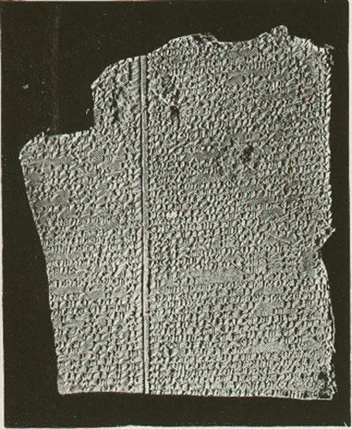
A Universal Flood
Gilgamesh Epic (excerpts)
  “the hearts of the Great Gods moved them to inflict the Flood.”
  “Tear down the house and build a boat!”
  “Make all living beings go up into the boat.”
  “The boat which you are to build, its dimensions must measure equal to each other; its length must correspond to its width.”
  “I provided it with six decks…”
Tablet 11
www.ancienttexts.org/library/mesopotamian/gilgamesh/tab11.htm

Slide 9
A Universal Flood
Gilgamesh Epic (excerpts)
  “Go inside the boat, seal the entry!”
  “The sea calmed, fell still, the whirlwind (and) flood stopped up. I looked around all day long--quiet had set in and all the human beings had turned to clay!”
  “On Mt. Nimush the boat lodged firm, Mt. Nimush held the boat, allowing no sway.”
  Sent a dove, a swallow, and a raven
  Sacrificed a sheep to the gods
Tablet 11
www.ancienttexts.org/library/mesopotamian/gilgamesh/tab11.htm

Slide 10
3. Historical Accuracy Of The Bible
Universal Flood (Gen. 6-8)
  Flood stories found in all parts of the world point to a flood that destroyed the whole world
  Handed down from generation to generation
  legendary material added subsequently
  A common point of origin
  Bible contains the true original

Slide 11
Man’s Contradictions
“Relatively recently, water blasted out from an underground aquifer on Mars, carving out deep flood channels in the surface that were later buried by lava flows…” (http://news.discovery.com/space/mars-underground-3d-observation-ancient-valley-130307.htm)
Evidence For Flood!
Belief in a cataclysmic flood on Mars in the past
Based on interpretation of radar imaging
Presently no liquid water on Mars

Slide 12

Man’s Contradictions
Yet regarding the Earth, “For nearly two centuries there has been overwhelming geological evidence that a global flood, as depicted in the story of Noah in the biblical book of Genesis, could not have happened. Not only is there not enough water in the Earth system to account for water levels above the highest mountaintop, but uniformly rising levels would not allow the water to have the erosive capabilities attributed to Noah's Flood…” (http://www.sciencedaily.com/releases/2012/08/120814135153.htm)

Slide 13
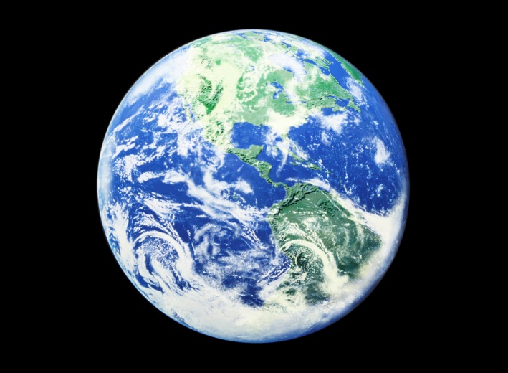
Man’s Contradictions
Why The Difference?
No Liquid Water, But
Evidence For Flood!
Lots Of Liquid water, But
No Evidence For Flood!
EARTH
Despite 71% of Earth’s surface is water
Despite marine fossils on mountain tops
Despite written testimony
Despite biblical testimony

Slide 14
A Prophecy of WHAT
Unbelievers Would Affirm

Slide 15
Man’s Contradictions
Uniformitarianism is the assumption that the same natural laws and processes that operate in the universe now have always operated in the universe in the past and apply everywhere in the universe. It has included the gradualistic concept that "the present is the key to the past" and is functioning at the same rates. (Wikipedia)
Why The Difference?
No Liquid Water, But
Evidence For Flood!
Lots Of Liquid water, But
No Evidence For Flood!
EARTH
Who?
When?
³ knowing this first: that scoffers will come in the last days, walking according to their own lusts,
⁴ and saying, "Where is the promise of His coming? For since the fathers fell asleep, all things continue as they were from the beginning of creation."
What?
2 Peter 3 (NKJV)

Slide 16

Man’s Contradictions
WHAT IS THE CENTRAL ISSUE AT HAND FOR SCOFFERS?
TIME
Millions of years!
³ knowing this first: that scoffers will come in the last days, walking according to their own lusts,
⁴ and saying, "Where is the promise of His coming? For since the fathers fell asleep, all things continue as they were from the beginning of creation."
2 Peter 3 (NKJV)

Slide 17
Man’s Contradictions
“Time is in fact the hero of the plot. The time with which we have to deal is of the order of two billion years. What we regard as impossible on the basis of human experience is meaningless here. Given so much time, the ‘impossible’ becomes possible, the possible probable, and the probable virtually certain. One has only to wait: time itself performs the miracles”
(George Wald, “The Origin of Life,” Scientific America, 191:48, August 1954)
³ knowing this first: that scoffers will come in the last days, walking according to their own lusts,
⁴ and saying, "Where is the promise of His coming? For since the fathers fell asleep, all things continue as they were from the beginning of creation."
2 Peter 3 (NKJV)

Slide 18
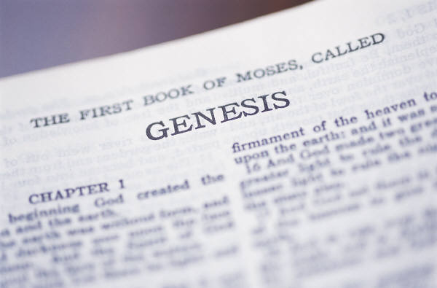

Pressing TIME
In Genesis 1
Fantastic opinions have been published and inserted into Genesis 1
  Day-age
  Non-consecutive day-age
  Revelation day-age
  Gap
All have one thing in common
TIME!

Slide 19

TIME
God is the creator of time as we know it (Gen. 1:1)
God is not bound to time
(2 Pet. 3:8)
God does not run out of time (Rev. 1:8; 21:6)
Time is something we need to respect and redeem (Ps. 90:12)
We only have so much time to get in a good relationship with God (Rev. 2:21; 2 Cor. 6:1, 2)
Our time on earth is always running out (Eccl. 12:1; Heb. 9:27)

